Slide 1
eXpertIze
Knowledge-based system

Slide 2
Knowledge Base
Knowledge base
Objects
examples:
Book
Chair
Table
Blackboard
Chalk
Computer
Relationships
examples:
can_be_opened_closed
can_put_in_backpack
can_use_elecricity
has_a_handle
And so on…

Slide 3
Objects
Knowledge in our system is represented with predicate logic
For example, object book.pl is described as:
can_put_in_backpack(book).
can_be_opened_closed(book).
consist_of_pages(book).
can_put_in_backpack
Book
can_be_opened_closed
consist_of_pages

Slide 4
Relations
Example of relation can_put_in_backpack.pl
Each relation is basically the attribute of an object
We can simulate subclasses
Possibility reduction tells us how reliable is the question (bad question: “is it big?”)
question_about('Can all variations of it be put in a backpack?',can_put_in_backpack).
possibility_reduction(0.5,can_put_in_backpack).
can_put_in_backpack(X) :- can_put_in_pocket(X).

Slide 5
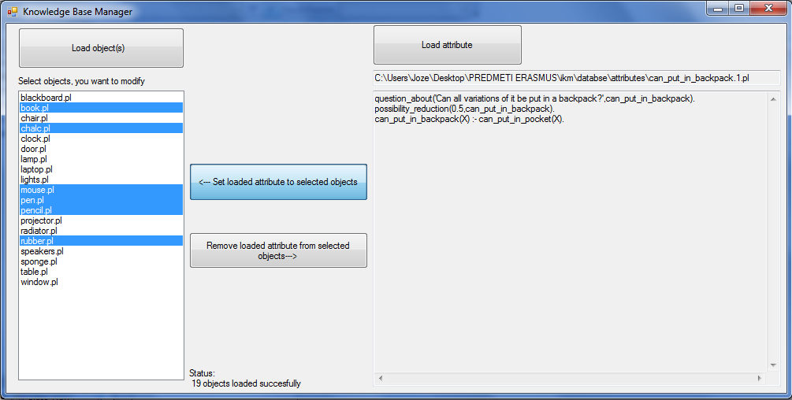
Knowledge Base Manager

Slide 6
Knowledge Base Manager
Knowledge Base Manager developed is in raw stage
It represents an idea of future development of the application
It has functions like
  Displaying attributes and its content
  Displaying loaded objects
  Assigning and removing attributes form the objects

Slide 7
Future work
Automated filling the knowledge base
Learning the system
More answers
Different types of questions

